Slide 1





Retail Recommender Solution Accelerator
Personalize customer retail experiences with Solution Accelerator
To create personalized customer retail experiences, your organization needs a solution that can leverage data to get valuable insights—fast. The new Retail Recommender Solution Accelerator is ready-to-deploy code that enables the capture of real-time customer data to deliver a tailored browsing experience through personalized product recommendations. The package provides end-to-end analytics, machine learning, and an easy-to-use API to provide insight to your organization.
Customer challenges
Behavior and purchasing data (online and in-person) reside in different systems and don’t support personalizing the customer experience
With apps in the cloud and in the datacenter, it takes too long to make consumer experience improvements
Competitors are personalizing the consumer relationship and taking market share
Solution Accelerator benefits
Quickly personalize customer experience with advanced analytics that track behavior
Easily launch and reduce development time with end-to-end unified analytics via Azure Synapse Analytics, Azure Machine Learning, and other Azure Big Data Services
Get technical support from Azure experts and the Microsoft partner network
78% of consumers are more likely to shop at retailers and brands providing a personalized experience.*
Customer Journey
Delight your customers with a smooth, personalized experience made possible with the Retail Recommender Solution Accelerator journey below:
Step 1
Step 2
Step 3
Step 4
The customer opens the app and logs in.
The customer gets a personalized page experience with purchase history, recommendations, and favorites as the retailer draws insights from the user profile and associated transactional data.
The customer receives recommendations from the retailer based on purchase history, selected products, and promotions.
The customer completes their purchase thanks to the personalized experience...
All in real time, while shopping
*McKinsey & Company: “The great consumer shift: Ten charts that show how US shopping behavior is changing,” Tamara Charm, Becca Coggins, Kelsey Robinson, and Jamie Wilkie, August 2020
©2021 Microsoft. All rights reserved.

Slide 2

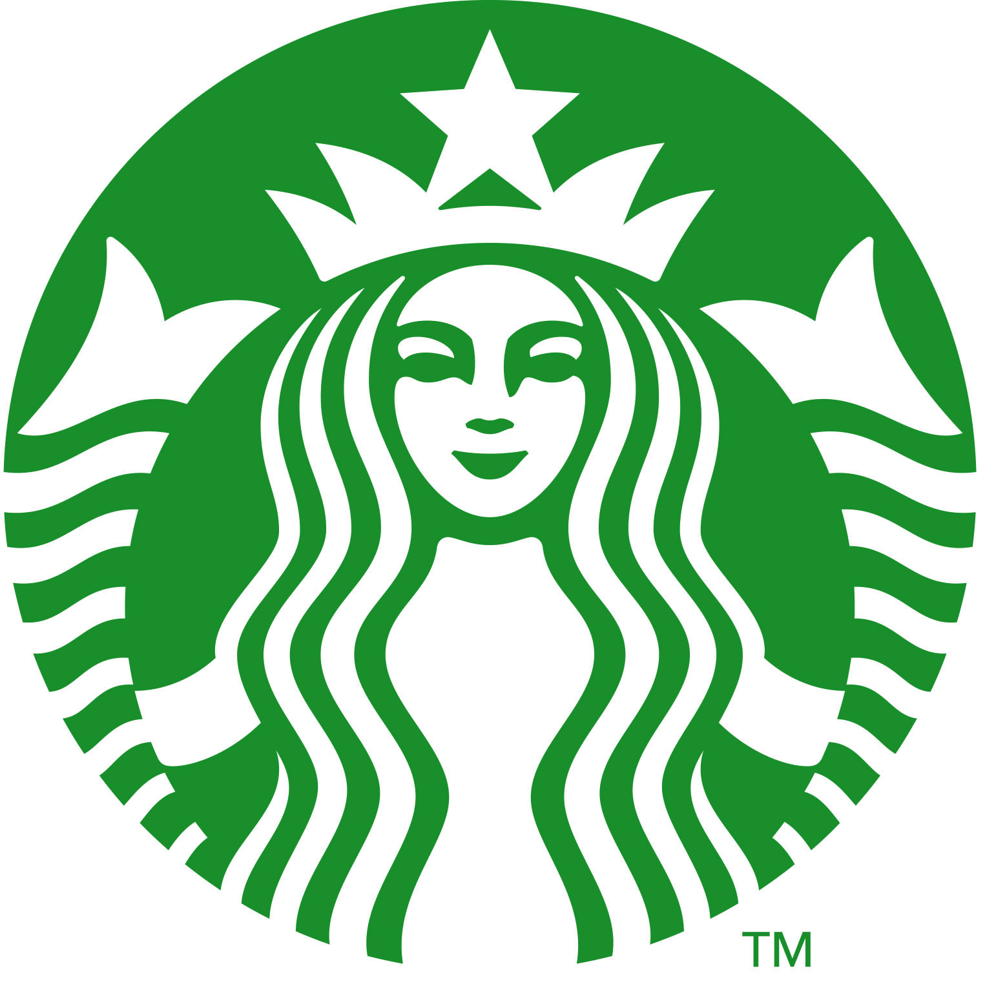
Customer Success Stories
Tractor Supply Company: The largest rural lifestyle retailer in the US needed a platform to respond to market changes and evolving customer needs. They wanted to deliver personalized, convenient shopping experiences anytime, anywhere. TSC chose Microsoft Azure to upgrade their e-commerce platform and to access insights that will enable deeper personalization. TSC has been able to use analytics to enhance the customer experience and support TSC’s ONETractor strategy.
Starbucks: The global coffee chain serves more than 100 million weekly customers and wanted to create an even more personalized experience. Starbucks turned to advanced Microsoft technology to gather data about shopper preferences, weather, time of day, and more to fine-tune personalized recommendations. Today its 16 million active Starbucks Rewards members now receive thoughtful recommendations from the app for food and drinks from their local store.
Give your customers a personalized shopping experience within weeks
Gain the valuable insights of this Solution Accelerator quickly with this easy-to-follow roadmap:
Kick-off
Proof of value
MVP & deployment
Learn more about the Demand Forecasting Solution Accelerator and see a demo
Solution code walk-through and prototype creation for customer testing
Minimum Viable Product (MVP) is built and deployed for the customer with support of the technical specialists (CSA) and Partners
With demo data, create your MVP in less than a day
With your custom data and a prep session, create your MVP in 2-5 weeks
How to get started
Contact your Microsoft specialist for a demo and to discuss prerequisites, next steps, and your questions.
©2021 Microsoft. All rights reserved.

